Slide 1
Graphs
Chapter 10

Slide 2
Chapter Summary
Graphs and Graph Models
Graph Terminology and Special Types of Graphs
Representing Graphs and Graph Isomorphism
Connectivity
Euler and Hamiltonian Graphs
Shortest-Path Problems
Planar Graphs
Graph Coloring

Slide 3
Graphs and Graph Models
Section 10.1

Slide 4
Section Summary
Introduction to Graphs
Graph Taxonomy
Graph Models

Slide 5
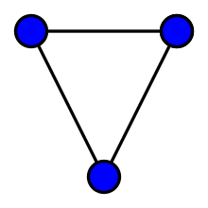
Chapter 10 Graphs
Definition: A graph G = (V, E) consists of a nonempty set V of vertices (or nodes) and a set E of edges. Each edge has either one or two vertices associated with it, called its endpoints. An edge is said to connect its endpoints.
Basic Types of GRAPH
Simple Graph
Multi Graph
Pseudo Graph
Null Graph
Complete Graph
Regular Graph

Slide 6
Some Terminology
In a simple graph each edge connects two different vertices and no two edges connect the same pair of vertices.
Multigraphs may have multiple edges connecting the same two vertices. When m different edges connect the vertices u and v, we say that {u,v} is an edge of multiplicity m.
An edge that connects a vertex to itself is called a loop.
A pseudograph may include loops, as well as multiple edges connecting the same pair of vertices.
Example:
This pseudograph has both multiple edges and a loop.
a
b
Remark: There is no standard terminology for graph theory. So, it is crucial that you understand the terminology being used whenever you read material about graphs.
c

Slide 7
Directed Graphs
Definition: An directed graph (or digraph) G = (V, E) consists of a nonempty set V of vertices (or nodes) and a set E of directed edges (or arcs). Each edge is associated with an ordered pair of vertices. The directed edge associated with the ordered pair (u,v) is said to start at u and end at v.
Remark:
Graphs where the end points of an edge are not ordered are said to be undirected graphs.

Slide 8
Some Terminology (continued)
A simple directed graph has no loops and no multiple edges.
A directed multigraph may have multiple directed edges. When there are m directed edges from the vertex u to the vertex v, we say that (u,v) is an edge of multiplicity m.
a
b
Example:
This is a directed graph with three vertices and four edges.
c
Example:
In this directed multigraph the multiplicity of (a,b) is 1 and the multiplicity of (b,c) is 2.
a
b
c

Slide 9
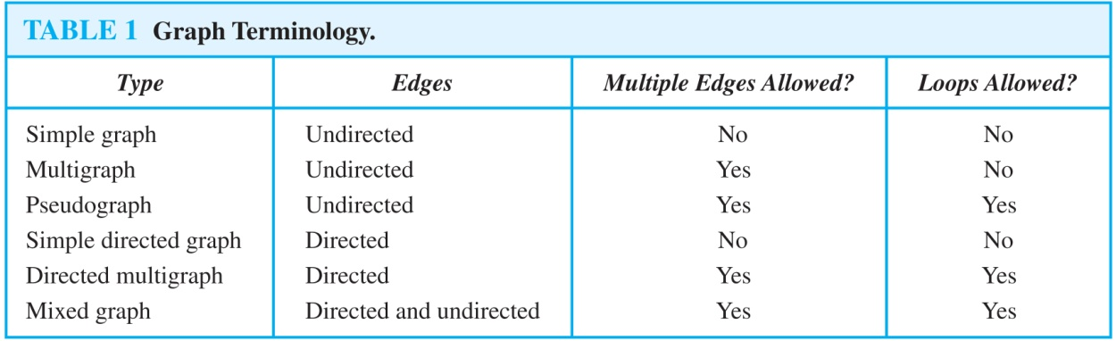
Graph Terminology: Summary
To understand the structure of a graph and to build a graph model, we ask these questions:
Are the edges of the graph undirected or directed (or both)?
If the edges are undirected, are multiple edges present that connect the same pair of vertices? If the edges are directed, are multiple directed edges present?
Are loops present?

Slide 10
Other Applications of Graphs
We will illustrate how graph theory can be used in models of:
Social networks
Communications networks
Information networks
Software design
Transportation networks
Biological networks
It’s a challenge to find a subject to which graph theory has not yet been applied. Can you find an area without applications of graph theory?

Slide 11
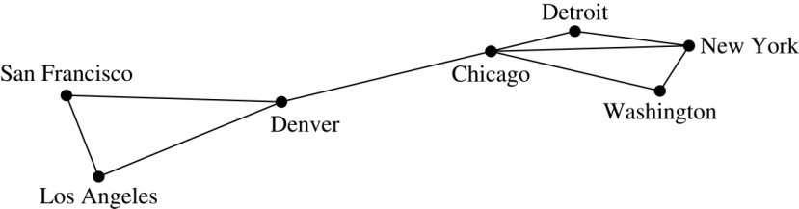
Graph Models: Computer Networks
When we build a graph model, we use the appropriate type of graph to capture the important features of the application.
We illustrate this process using graph models of different types of computer networks. In all these graph models, the vertices represent data centers and the edges represent communication links.
To model a computer network where we are only concerned whether two data centers are connected by a communications link, we use a simple graph. This is the appropriate type of graph when we only care whether two data centers are directly linked (and not how many links there may be) and all communications links work in both directions.

Slide 12
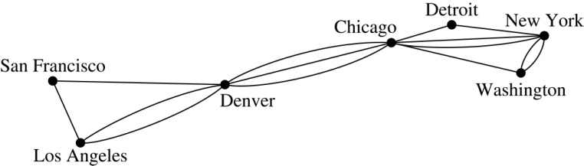
Graph Models: Computer Networks (continued)
To model a computer network where we care about the number of links between data centers, we use a multigraph.

Slide 13
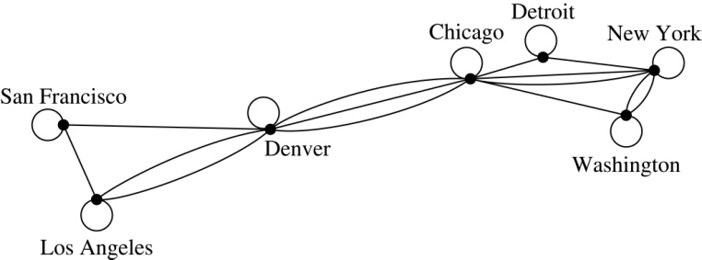
Graph Models: Computer Networks
To model a computer network with diagnostic links at data centers, we use a pseudograph, as loops are needed.

Slide 14
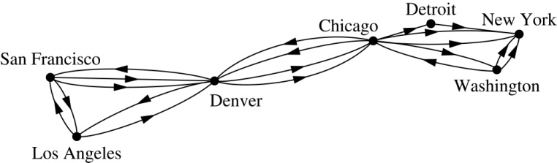
Graph Models: Computer Networks
To model a network with multiple one-way links, we use a directed multigraph. Note that we could use a directed graph without multiple edges if we only care whether there is at least one link from a data center to another data center.

Slide 15
Graph Models: Social Networks
Graphs can be used to model social structures based on different kinds of relationships between people or groups.
In a social network, vertices represent individuals or organizations and edges represent relationships between them.
Useful graph models of social networks include:
friendship graphs - undirected graphs where two people are connected if they are friends (in the real world, on Facebook, or in a particular virtual world, and so on.)
collaboration graphs - undirected graphs where two people are connected if they collaborate in a specific way
influence graphs - directed graphs where there is an edge from one person to another if the first person can influence the second person..

Slide 16
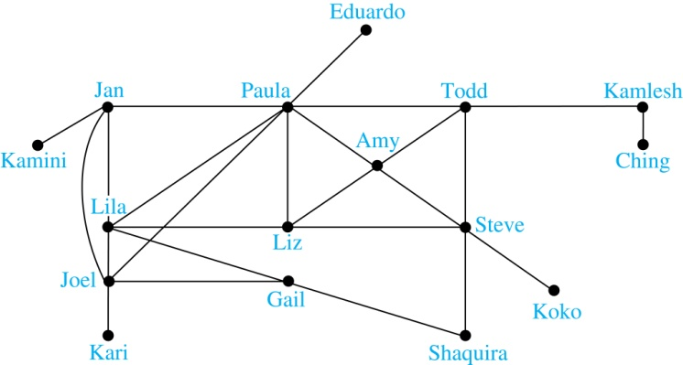
Graph Models: Social Networks
Example: A friendship graph where two people are connected if they are Facebook friends.

Slide 17
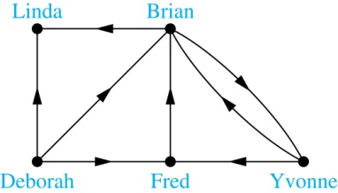
Graph Models: Social Networks
Example: An influence graph

Slide 18
Applications to Information Networks
Graphs can be used to model different types of networks that link different types of information.
In a web graph, web pages are represented by vertices and links are represented by directed edges.
A web graph models the web at a particular time.
We will explain how the web graph is used by search engines in Section 11.4.
In a citation network:
Research papers in a particular discipline are represented by vertices.
When a paper cites a second paper as a reference, there is an edge from the vertex representing this paper to the vertex representing the second paper.

Slide 19
Transportation Graphs
Graph models are extensively used in the study of transportation networks.
Airline networks can be modeled using directed multigraphs where
airports are represented by vertices
each flight is represented by a directed edge from the vertex representing the departure airport to the vertex representing the destination airport
Road networks can be modeled using graphs where
vertices represent intersections and edges represent roads.
undirected edges represent two-way roads and directed edges represent one-way roads.

Slide 20
Software Design Applications
Graph models are extensively used in software design. We will introduce two such models here; one representing the dependency between the modules of a software application and the other representing restrictions in the execution of statements in computer programs.
When a top-down approach is used to design software, the system is divided into modules, each performing a specific task.
We use a module dependency graph to represent the dependency between these modules. These dependencies need to be understood before coding can be done.

Slide 21
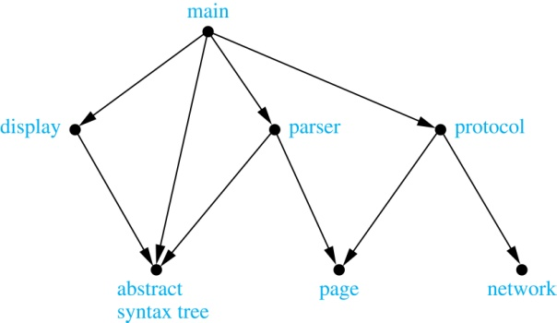
Software Design Applications
In a module dependency graph vertices represent software modules and there is an edge from one module to another if the second module depends on the first.
Example: The dependencies between the seven modules in the design of a web browser are represented by this module dependency graph.

Slide 22
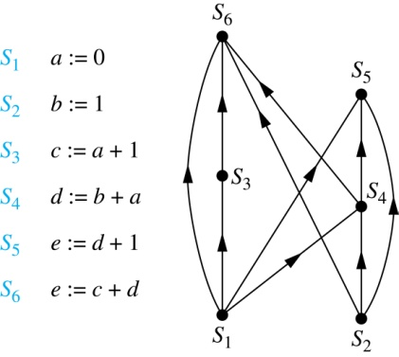
Software Design Applications
We can use a directed graph called a precedence graph to represent which statements must have already been executed before we execute each statement.
Vertices represent statements in a computer program
There is a directed edge from a vertex to a second vertex if the second vertex cannot be executed before the first
Example: This precedence graph shows which statements must already have been executed before we can execute each of the six statements in the program.

Slide 23
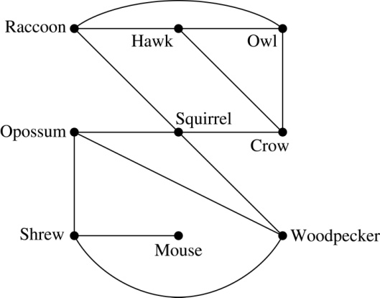
Biological Applications
Graph models are used extensively in many areas of the biological science. We will describe two such models, one to ecology and the other to molecular biology.
Niche overlap graphs model competition between species in an ecosystem
Vertices represent species and an edge connects two vertices when they represent species who compete for food resources.
Example: This is the niche overlap graph for a forest ecosystem with nine species.

Slide 24
Biological Applications
We can model the interaction of proteins in a cell using a protein interaction network.
In a protein interaction graph, vertices represent proteins and vertices are connected by an edge if the proteins they represent interact.
Protein interaction graphs can be huge and can contain more than 100,000 vertices, each representing a different protein, and more than 1,000,000 edges, each representing an interaction between proteins
Protein interaction graphs are often split into smaller graphs, called modules, which represent the interactions between proteins involved in a particular function.

Slide 25
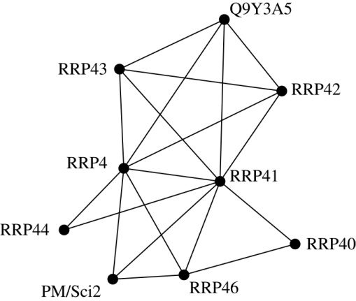
Biological Applications
Example: This is a module of the protein interaction graph of
proteins that degrade RNA in a human cell.

Slide 26
Graph Terminology and Special Types of Graphs
Section 10.2

Slide 27
Section Summary
Basic Terminology
Some Special Types of Graphs
Bipartite Graphs
Bipartite Graphs and Matchings
Some Applications of Special Types of Graphs
New Graphs from Old

Slide 28
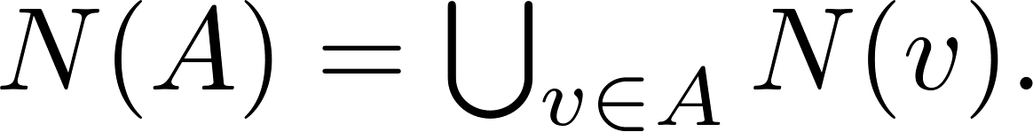
Basic Terminology
Definition 1. Two vertices u, v in an undirected graph G are called adjacent (or neighbors) in G if there is an edge e between u and v. Such an edge e is called incident with the vertices u and v and e is said to connect u and v.
Definition 2. The set of all neighbors of a vertex v of G = (V, E), denoted by N(v), is called the neighborhood of v. If A is a subset of V, we denote by N(A) the set of all vertices in G that are adjacent to at least one vertex in A. So,
Definition 3. The degree of a vertex in a undirected graph is the number of edges incident with it, except that a loop at a vertex contributes two to the degree of that vertex. The degree of the vertex v is denoted by deg(v).

Slide 29
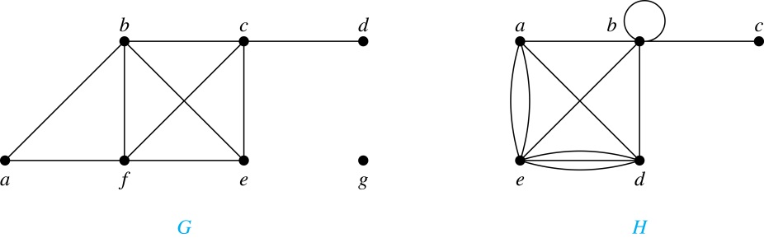
Degrees and Neighborhoods of Vertices
Example: What are the degrees and neighborhoods of the vertices in the graphs G and H?
Solution:
G: deg(a) = 2, deg(b) = deg(c) = deg(f ) = 4, deg(d ) = 1, deg(e) = 3, deg(g) = 0.
N(a) = {b, f }, N(b) = {a, c, e, f }, N(c) = {b, d, e, f }, N(d) = {c},
N(e) = {b, c , f }, N(f) = {a, b, c, e}, N(g) = ∅ .
H: deg(a) = 4, deg(b) = deg(e) = 6, deg(c) = 1, deg(d) = 5.
N(a) = {b, d, e}, N(b) = {a, b, c, d, e}, N(c) = {b}, N(d) = {a, b, e},
N(e) = {a, b ,d}.

Slide 30
Handshaking Theorem
Theorem: If G is any graph, then the sum of the degrees of all the vertices of G equals twice the number of edges of G.
Specifically, if the vertices of G are v1, v2, …, vn, where n is a positive integer, then
the total degree of G = deg(v1) + deg(v2) + … + deg(vn) = 2 . (the number of edges of G)
PROOF:
Each edge “e” of G connects its end points vi and vj. This edge, therefore contributes 1 to the degree of vi and 1 to the degree of vj.
If “e” is a loop, then it is counted twice in computing the degree of the vertex on which it is incident.
Accordingly, each edge of G contributes 2 to the total degree of G.
Thus, the total degree of G = 2. (the number of edges of G)
COROLLARY: The total degree of G is an even number

Slide 31
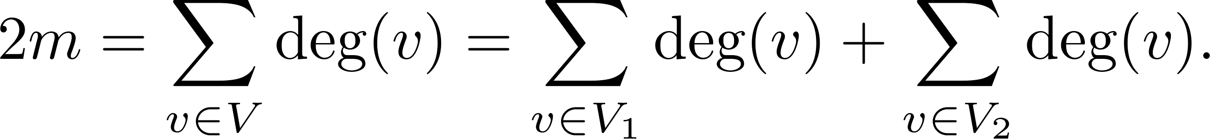
Degree of Vertices
Theorem: An undirected graph has an even number of vertices of odd degree.
Proof: Let V₁ be the vertices of even degree and V₂ be the vertices of odd degree in an undirected graph G = (V, E) with m edges. Then
even
must be even since deg(v) is even for each v ∈ V₁
This sum must be even because 2m is even and the sum of the degrees of the vertices of even degrees is also even. Because this is the sum of the degrees of all vertices of odd degree in the graph, there must be an even number of such vertices.

Slide 33
Handshaking Theorem
We now give two examples illustrating the usefulness of the handshaking theorem.
Example: How many edges are there in a graph with 10 vertices of degree six?
Solution: Because the sum of the degrees of the vertices is 6 ⋅ 10 = 60, the handshaking theorem tells us that 2m = 60. So the number of edges m = 30.
Example: If a graph has 5 vertices, can each vertex have degree 3?
Solution: This is not possible by the handshaking theorem, because the sum of the degrees of the vertices 3 ⋅ 5 = 15 is odd.

Slide 34
Directed Graphs
Recall the definition of a directed graph.
Definition: An directed graph G = (V, E) consists of V, a nonempty set of vertices (or nodes), and E, a set of directed edges or arcs. Each edge is an ordered pair of vertices. The directed edge (u,v) is said to start at u and end at v.
Definition: Let (u,v) be an edge in G. Then u is the initial vertex of this edge and is adjacent to v and v is the terminal (or end) vertex of this edge and is adjacent from u. The initial and terminal vertices of a loop are the same.

Slide 35
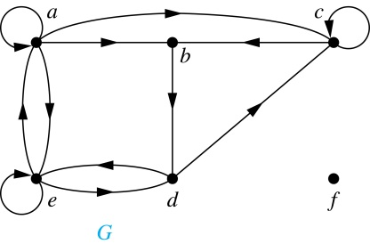
Directed Graphs (continued)
Definition: The in-degree of a vertex v, denoted deg⁻(v), is the number of edges which terminate at v. The out-degree of v, denoted deg⁺(v), is the number of edges with v as their initial vertex. Note that a loop at a vertex contributes 1 to both the in-degree and the out-degree of the vertex.
Example: In the graph G we have
deg⁻(a) = 2, deg⁻(b) = 2, deg⁻(c) = 3, deg⁻(d) = 2, deg⁻(e) = 3, deg⁻(f) = 0.
deg⁺(a) = 4, deg⁺(b) = 1, deg⁺(c) = 2, deg⁺(d) = 2, deg⁺ (e) = 3, deg⁺(f) = 0.

Slide 36
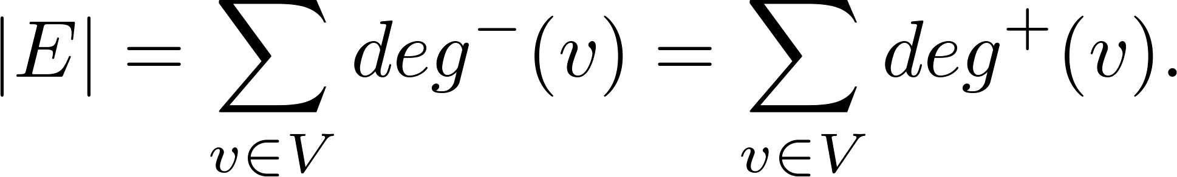
Directed Graphs (continued)
Theorem 3: Let G = (V, E) be a graph with directed edges. Then:
Proof: The first sum counts the number of outgoing edges over all vertices and the second sum counts the number of incoming edges over all vertices. It follows that both sums equal the number of edges in the graph.

Slide 37
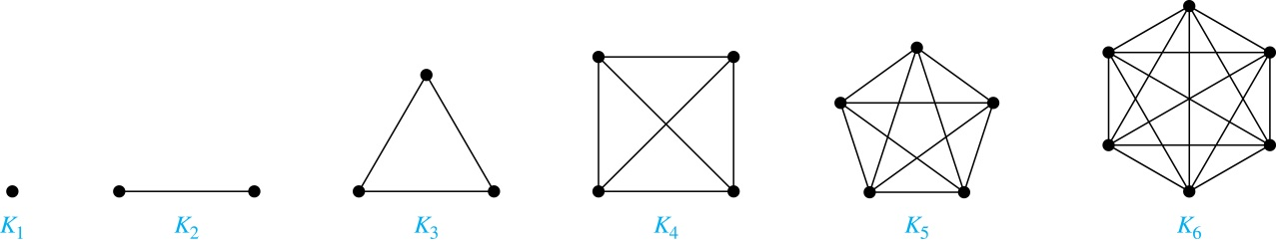
Special Types of Simple Graphs: Complete Graphs
A complete graph on n vertices, denoted by K_{n}, is the simple graph that contains exactly one edge between each pair of distinct vertices.

Slide 38
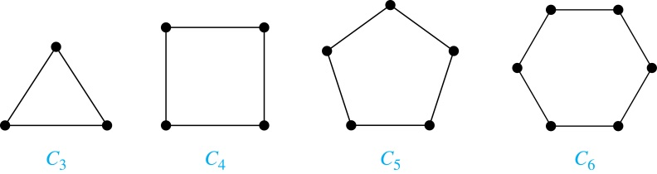
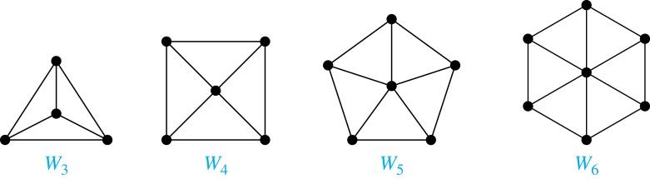
Special Types of Simple Graphs: Cycles and Wheels
A cycle C_{n} for n ≥ 3 consists of n vertices v₁, v₂ ,⋯ , v_{n}, and edges {v₁, v₂}, {v₂, v₃} ,⋯ , {v_{n-1}, v_{n}}, {v_{n}, v₁}.
A wheel W_{n} is obtained by adding an additional vertex to a cycle C_{n} for n ≥ 3 and connecting this new vertex to each of the n vertices in C_{n} by new edges.

Slide 39
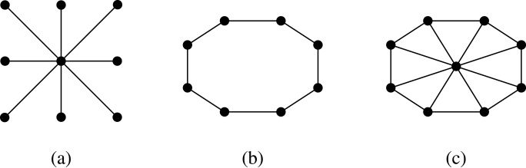
Special Types of Graphs and Computer Network Architecture
Various special graphs play an important role in the design of computer networks.
Some local area networks use a star topology, which is a complete bipartite graph K_{1,n} ,as shown in (a). All devices are connected to a central control device.
Other local networks are based on a ring topology, where each device is connected to exactly two others using C_{n} ,as illustrated in (b). Messages may be sent around the ring.
Others, as illustrated in (c), use a W_{n} – based topology, combining the features of a star topology and a ring topology.

Slide 40
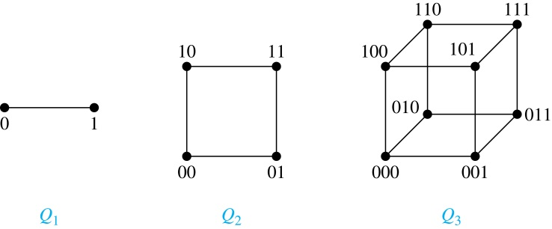
Special Types of Simple Graphs: n-Cubes
An n-dimensional hypercube, or n-cube, Q_{n}, is a graph with 2^{n} vertices representing all bit strings of length n, where there is an edge between two vertices that differ in exactly one bit position.

Slide 41
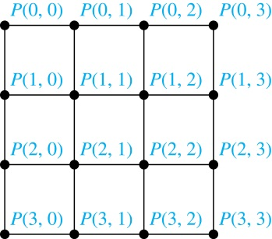
Special Types of Graphs and Computer Network Architecture
Various special graphs also play a role in parallel processing where processors need to be interconnected as one processor may need the output generated by another.
The n-dimensional hypercube, or n-cube, Qn, is a common way to connect processors in parallel, e.g., Intel Hypercube.
Another common method is the mesh network, illustrated here for 16 processors.

Slide 42
Bipartite Graphs
Definition: A simple graph G is bipartite if V can be partitioned into two disjoint subsets V₁ and V₂ such that every edge connects a vertex in V₁ and a vertex in V₂. In other words, there are no edges which connect two vertices in V₁ or in V₂.
It is not hard to show that an equivalent definition of a bipartite graph is a graph where it is possible to color the vertices red or blue so that no two adjacent vertices are the same color.

Slide 43
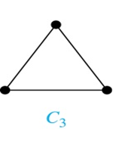
Bipartite Graphs (continued)
Example: Show that C₃ is not bipartite.
Solution: If we divide the vertex set of C₃ into two nonempty sets, one of the two must contain two vertices. But in C₃ every vertex is connected to every other vertex. Therefore, the two vertices in the same partition are connected. Hence, C₃ is not bipartite.

Slide 44
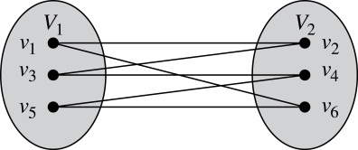
Bipartite Graphs (continued)
Example: Show that C₆ is bipartite.
Solution: We can partition the vertex set into
V₁ = {v₁, v₃, v₅} and V₂ = {v₂, v₄, v₆} so that every edge of C₆ connects a vertex in V₁ and V₂ .

Slide 45
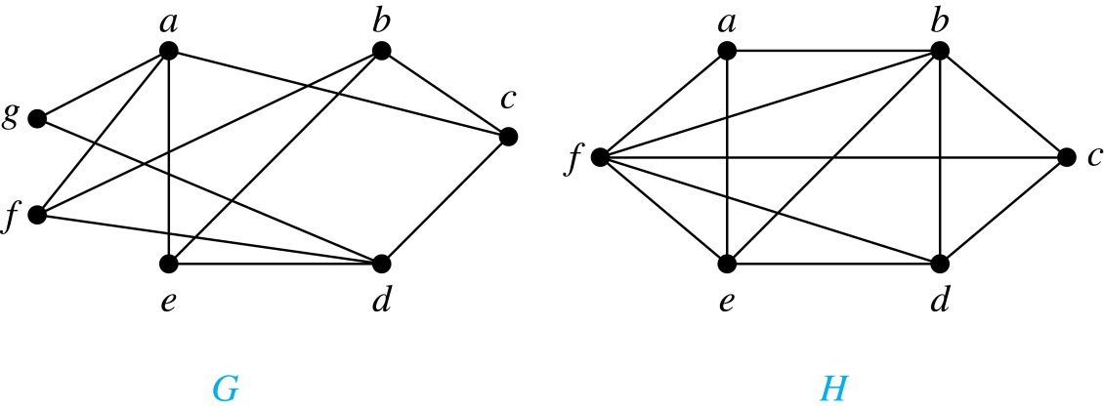
Bipartite Graphs
G is bipartite
H is not bipartite since if we color a red, then the adjacent vertices f and b must both be blue.

Slide 46
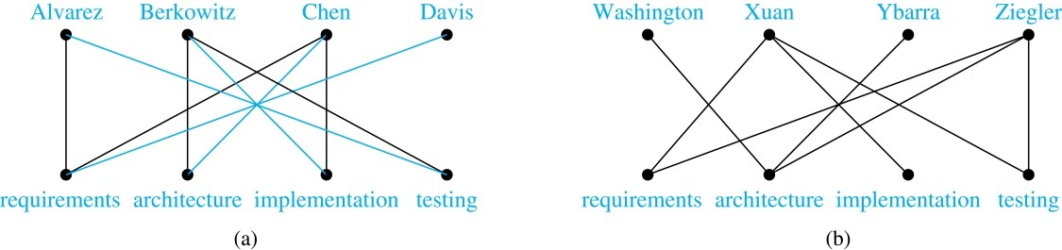
Bipartite Graphs and Matchings
Bipartite graphs are used to model applications that involve matching the elements of one set to elements in another, for example:
Job assignments - vertices represent the jobs and the employees, edges link employees with those jobs they have been trained to do. A common goal is to match jobs to employees so that the most jobs are done.

Slide 47
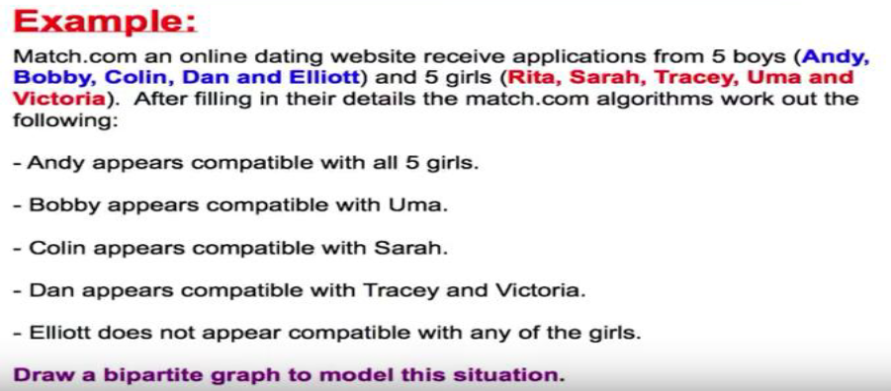
Bipartite Graphs and Matchings

Slide 48
Bipartite Graphs and Matchings

Slide 49
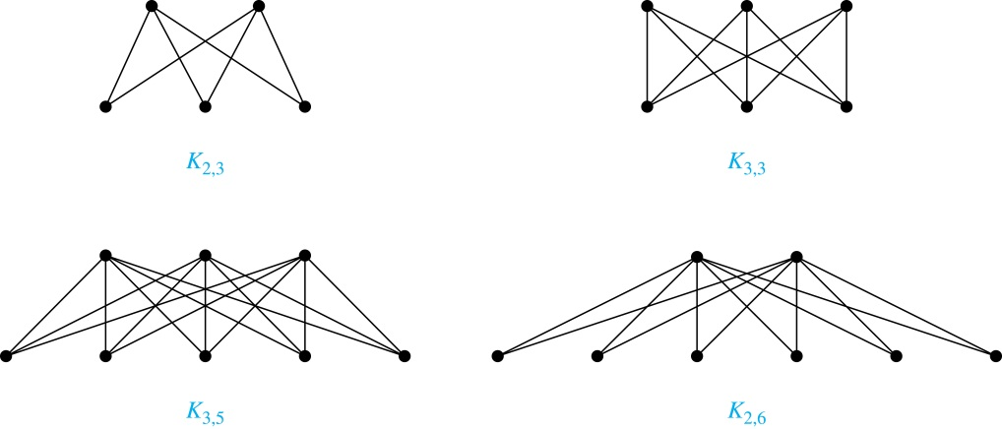
Complete Bipartite Graphs
Definition: A complete bipartite graph K_{m,n} is a graph that has its vertex set partitioned into two subsets V₁ of size m and V₂ of size n such that there is an edge from every vertex in V₁ to every vertex in V₂.
Example: We display four complete bipartite graphs here.

Slide 50
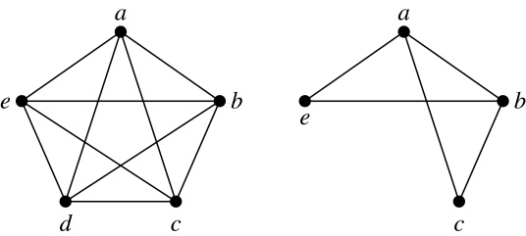
New Graphs from Old
Definition: A subgraph of a graph G = (V,E) is a graph (W,F), where W ⊂ V and F ⊂ E. A subgraph H of G is a proper subgraph of G if H ≠ G.
Example: Here we show K₅ and one of its subgraphs.
Definition: Let G = (V, E) be a simple graph. The subgraph induced by a subset W of the vertex set V is the graph (W,F), where the edge set F contains an edge in E if and only if both endpoints are in W.
Example: Here we show K₅ and the subgraph induced by W = {a,b,c,e}.

Slide 51
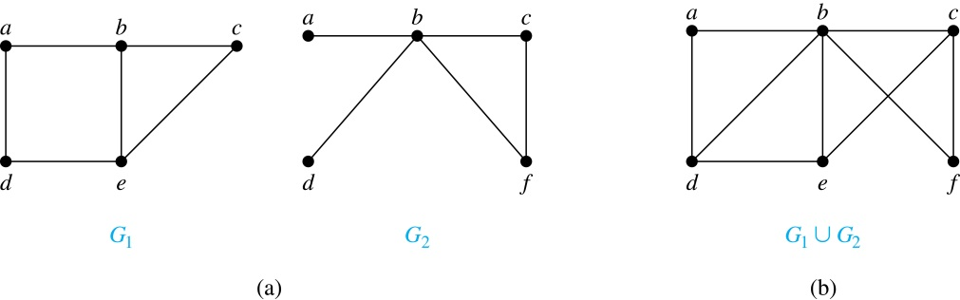
New Graphs from Old (continued)
Definition: The union of two simple graphs G₁ = (V₁, E₁) and G₂ = (V₂, E₂) is the simple graph with vertex set V₁ ⋃ V₂ and edge set E₁ ⋃ E₂. The union of G₁ and G₂ is denoted by G₁ ⋃ G₂.
Example:

Slide 52
Representations of Graphs
Section 10.3

Slide 53
Section Summary
Adjacency Lists
Adjacency Matrices
Incidence Matrices

Slide 54
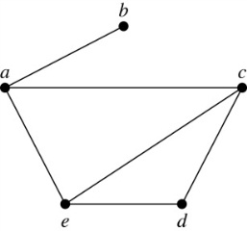
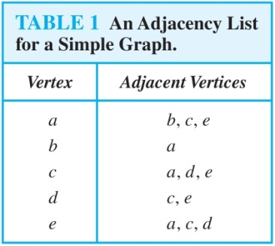
Representing Graphs: Adjacency Lists
Definition: An adjacency list can be used to represent a graph with no multiple edges by specifying the vertices that are adjacent to each vertex of the graph.
Example:

Slide 55
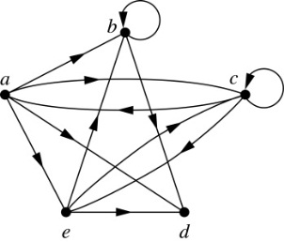
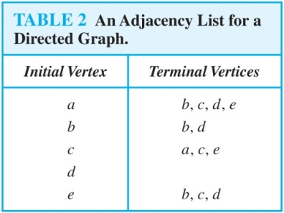
Representing Graphs: Adjacency Lists
Example:

Slide 56
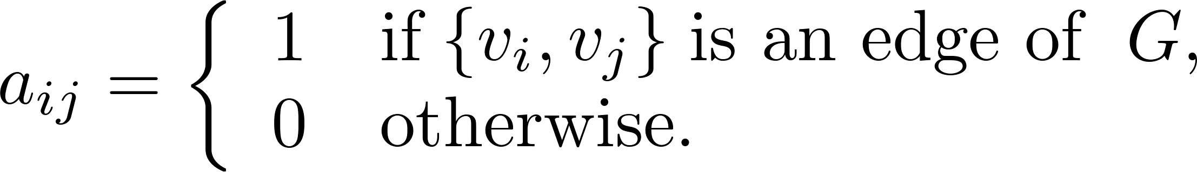
Representation of Graphs: Adjacency Matrices
Definition: Suppose that G = (V, E) is a simple graph where |V| = n. Arbitrarily list the vertices of G as v₁, v₂, … , v_{n}. The adjacency matrix A_{G} of G, with respect to the listing of vertices, is the n × n zero-one matrix with 1 as its (i, j)th entry when v_{i} and v_{j} are adjacent, and 0 as its (i, j)th entry when they are not adjacent.
In other words, if the graphs adjacency matrix is A_{G} = [a_{ij}], then

Slide 57
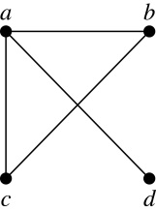
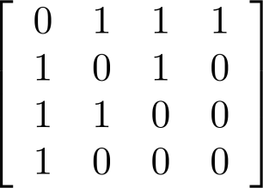
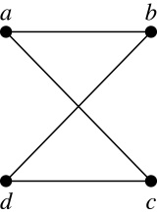
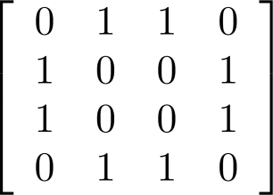
Adjacency Matrices (continued)
Example:
When a graph is sparse, that is, it has few edges relatively to the total number of possible edges, it is much more efficient to represent the graph using an adjacency list than an adjacency matrix. But for a dense graph, which includes a high percentage of possible edges, an adjacency matrix is preferable.
The ordering
of vertices is a, b, c, d.
The ordering of vertices is a, b, c, d.
Note: The adjacency matrix of a simple graph is symmetric, i.e., a_{ij} = a_{ji}
Also, since there are no loops, each diagonal entry a_{ij} for i = 1, 2, 3, …, n, is 0.

Slide 58
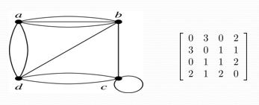
Adjacency Matrices (continued)
Adjacency matrices can also be used to represent graphs with loops and multiple edges.
A loop at the vertex vi is represented by a 1 at the (i, j)th position of the matrix.
When multiple edges connect the same pair of vertices vi and vj, (or if multiple loops are present at the same vertex), the (i, j)th entry equals the number of edges connecting the pair of vertices.
Example: We give the adjacency matrix of the pseudograph shown here using the ordering of vertices a, b, c, d.

Slide 59
Adjacency Matrices (continued)
Adjacency matrices can also be used to represent directed graphs. The matrix for a directed graph G = (V, E) has a 1 in its (i, j)th position if there is an edge from v_{i} to v_{j}, where v₁, v₂, … v_{n} is a list of the vertices.
In other words, if the graphs adjacency matrix is A_{G} = [a_{ij}], then
The adjacency matrix for a directed graph does not have to be symmetric, because there may not be an edge from v_{i} to v_{j}, when there is an edge from v_{j} to v_{i}.
To represent directed multigraphs, the value of a_{ij} is the number of edges connecting v_{i} to v_{j}.

Slide 60
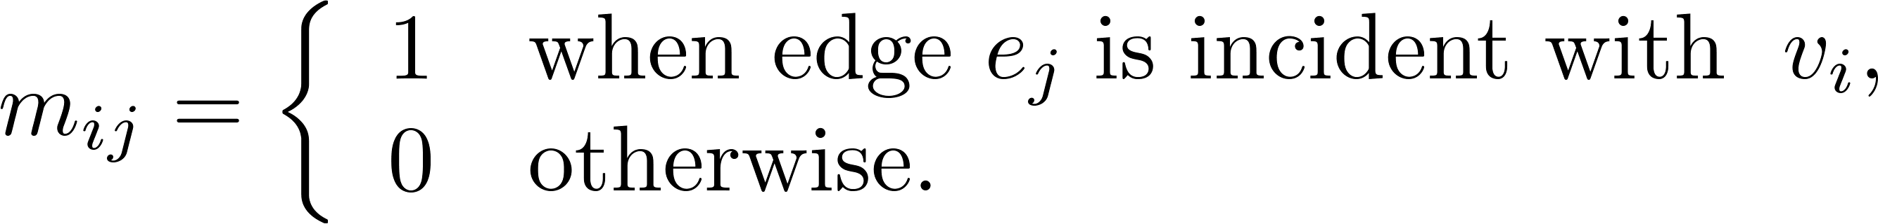
Representation of Graphs: Incidence Matrices
Definition: Let G = (V, E) be an undirected graph with vertices where v₁, v₂, … v_{n} and edges e₁, e₂, … e_{m}. The incidence matrix with respect to the ordering of V and E is the n × m matrix M = [m_{ij}], where

Slide 61
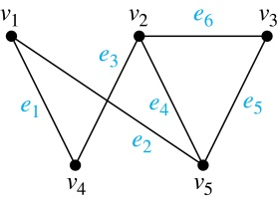
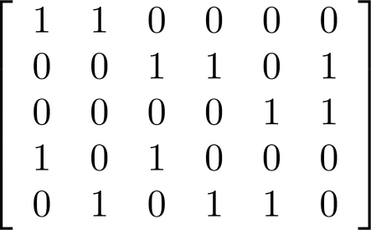
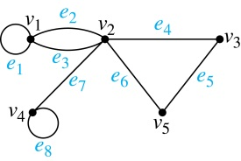
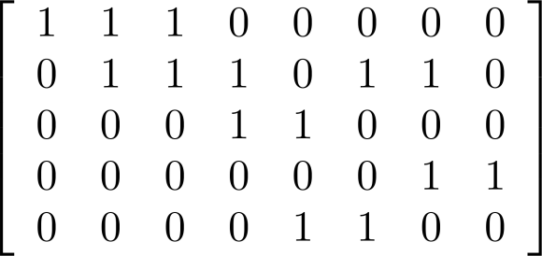
Incidence Matrices (continued)
Example: Simple Graph and Incidence Matrix
The rows going from top to bottom represent v₁ through v₅ and the columns going from left to right represent e₁ through e₆.
Example: Pseudograph and Incidence Matrix
The rows going from top to bottom represent v₁ through v₅ and the columns going from left to right represent e₁ through e₈.

Slide 62
Connectivity
Section 10.4

Slide 63
Section Summary
Paths
Connectedness in Undirected Graphs
Connectedness in Directed Graphs
Counting Paths between Vertices

Slide 64
Paths
Informal Definition: A path is a sequence of edges that begins at a vertex of a graph and travels from vertex to vertex along edges of the graph. As the path travels along its edges, it visits the vertices along this path, that is, the endpoints of these.
Applications: Numerous problems can be modeled with paths formed by traveling along edges of graphs such as:
determining whether a message can be sent between two computers.
efficiently planning routes for mail delivery.

Slide 65
Paths
Definition: Let n be a nonnegative integer and G an undirected graph. A path of length n from u to v in G is a sequence of n edges e₁, … , e_{n} of G for which there exists a sequence x₀ = u, x₁, …, x_{n-1}, x_{n} = v of vertices such that e_{i} has, for i = 1, …, n, the endpoints x_{i-1} and x_{i}.
When the graph is simple, we denote this path by its vertex sequence x₀, x₁, … , x_{n}(since listing the vertices uniquely determines the path).
The path is a circuit if it begins and ends at the same vertex (u = v) and has length greater than zero.
The path or circuit is said to pass through the vertices x₁, x₂, … , x_{n-1} and traverse the edges e₁, … , e_{n}.
A path or circuit is simple if it does not contain the same edge more than once.

Slide 66
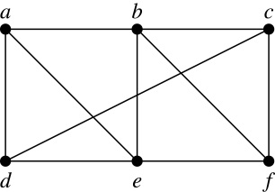
Paths (continued)
Example: In the simple graph here:
a, d, c, f, e is a simple path of length 4.
d, e, c, a is not a path because e is not connected to c.
b, c, f, e, b is a circuit of length 4.
a, b, e, d, a, b is a path of length 5, but it is not a simple path.

Slide 67
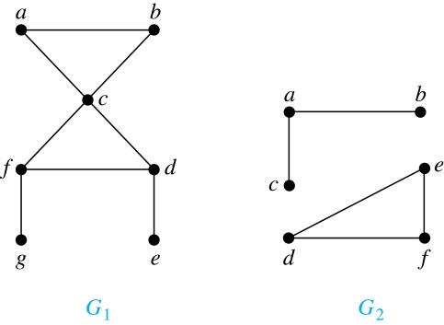
Connectedness in Undirected Graphs
Definition: An undirected graph is called connected if there is a path between every pair of vertices. An undirected graph that is not connected is called disconnected. We say that we disconnect a graph when we remove vertices or edges, or both, to produce a disconnected subgraph.
Example: G₁ is connected because there is a path between any pair of its vertices, as can be easily seen. However G₂ is not connected because there is no path between vertices a and f, for example.

Slide 68
Euler and Hamiltonian Graphs
Section 10.5

Slide 69
Section Summary
Euler Paths and Circuits
Hamilton Paths and Circuits
Applications of Hamilton Circuits

Slide 70
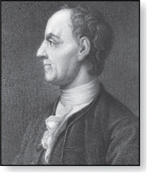
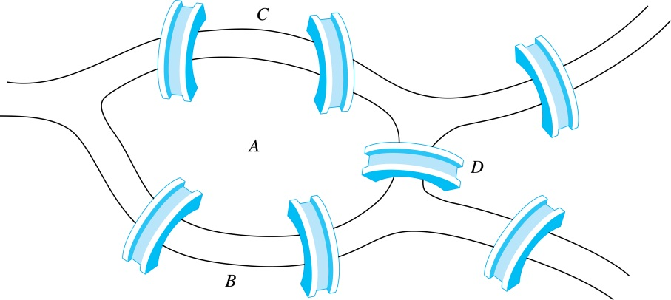

Euler Paths and Circuits
The town of Kӧnigsberg, Prussia
(now Kalingrad, Russia) was divided into
four sections by the branches of the Pregel river. In the 18th century seven bridges connected these regions.
People wondered whether whether it was possible to follow a path that crosses each bridge exactly once and returns to the starting point.
The Swiss mathematician Leonard Euler proved that no such path exists. This result is often considered to be the first theorem ever proved in graph theory.
Leonard Euler (1707-1783)
Multigraph Model of the Bridges of Kӧnigsberg
The 7 Bridges of Kӧnigsberg

Slide 71

Euler Paths and Circuits
Definition: An Euler circuit in a graph G is a simple circuit containing every edge of G. An Euler path in G is a simple path containing every edge of G.
Example: Which of the undirected graphs G₁, G₂, and G₃ has a Euler circuit? Of those that do not, which has an Euler path?
Solution: The graph G₁ has an Euler circuit (e.g., a, e, c, d, e, b, a). But, as can easily be verified by inspection, neither G₂ nor G₃ has an Euler circuit. Note that G₃ has an Euler path (e.g., a, c, d, e, b, d, a, b), but there is no Euler path in G₂, which can be verified by inspection.

Slide 72
Necessary Conditions for Euler Circuits and Paths
An Euler circuit begins with a vertex a and continues with an edge incident with a, say {a, b}. The edge {a, b} contributes one to deg(a).
Each time the circuit passes through a vertex it contributes two to the vertex’s degree.
Finally, the circuit terminates where it started, contributing one to deg(a). Therefore deg(a) must be even.
We conclude that the degree of every other vertex must also be even.
By the same reasoning, we see that the initial vertex and the final vertex of an Euler path have odd degree, while every other vertex has even degree. So, a graph with an Euler path has exactly two vertices of odd degree.
In the next slide we will show that these necessary conditions are also sufficient conditions.

Slide 73

Sufficient Conditions for Euler Circuits and Paths
Suppose that G is a connected multigraph with ≥ 2 vertices, all of even degree. Let x₀ = a be a vertex of even degree. Choose an edge {x₀, x₁} incident with a and proceed to build a simple path {x₀, x₁}, {x₁, x₂}, …, {x_{n-1}, x_{n}} by adding edges one by one until another edge can not be added.
The path begins at a with an edge of the
form {a, x}; we show that it must terminate
at a with an edge of the form {y, a}. Since each vertex has an even degree, there must be an even number of edges incident with this vertex. Hence, every time we enter a vertex other than a, we can leave it. Therefore, the path can only end at a.
If all of the edges have been used, an Euler circuit has been constructed. Otherwise, consider the subgraph H obtained from G by deleting the edges already used.
We illustrate this idea in the graph G here. We begin at a and choose the edges {a, f}, {f, c}, {c, b}, and {b, a} in succession.
In the example H consists of the vertices c, d, e.

Slide 74
Sufficient Conditions for Euler Circuits and Paths
Because G is connected, H must have at least one vertex in common with the circuit that has been deleted.
Every vertex in H must have even degree because all the vertices in G have even degree and for each vertex, pairs of edges incident with this vertex have been deleted. Beginning with the shared vertex construct a path ending in the same vertex (as was done before). Then splice this new circuit into the original circuit.
Continue this process until all edges have been used. This produces an Euler circuit. Since every edge is included and no edge is included more than once.
Similar reasoning can be used to show that a graph with exactly two vertices of odd degree must have an Euler path connecting these two vertices of odd degree
In the example, the vertex is c.
In the example, we end up with the circuit a, f, c, d, e, c, b, a.

Slide 75
Algorithm for Constructing an Euler Circuits
In our proof we developed this algorithms for constructing a Euler circuit in a graph with no vertices of odd degree.
procedure Euler(G: connected multigraph with all vertices of even degree)
circuit := a circuit in G beginning at an arbitrarily chosen vertex with edges
successively added to form a path that returns to this vertex.
H := G with the edges of this circuit removed
while H has edges
subciruit := a circuit in H beginning at a vertex in H that also is
an endpoint of an edge in circuit.
H := H with edges of subciruit and all isolated vertices removed
circuit := circuit with subcircuit inserted at the appropriate vertex.
return circuit{circuit is an Euler circuit}

Slide 76
Necessary and Sufficient Conditions for Euler Circuits and Paths (continued)
Theorem: A connected multigraph with at least two vertices has an Euler circuit if and only if each of its vertices has an even degree and it has an Euler path if and only if it has exactly two vertices of odd degree.
Example: Two of the vertices in the multigraph model of the Kӧnigsberg bridge problem have odd degree. Hence, there is no Euler circuit in this multigraph and it is impossible to start at a given point, cross each bridge exactly once, and return to the starting point.

Slide 77

Euler Circuits and Paths
Example:
G₁ contains exactly two vertices of odd degree (b and d). Hence it has an Euler path, e.g., d, a, b, c, d, b.
G₂ has exactly two vertices of odd degree (b and d). Hence it has an Euler path, e.g., b, a, g, f, e, d, c, g, b, c, f, d.
G₃ has six vertices of odd degree. Hence, it does not have an Euler path.

Slide 78
Applications of Euler Paths and Circuits
Euler paths and circuits can be used to solve many practical problems such as finding a path or circuit that traverses each
street in a neighborhood,
road in a transportation network,
connection in a utility grid,
link in a communications network.
Other applications are found in the
layout of circuits,
network multicasting,
molecular biology, where Euler paths are used in the sequencing of DNA.

Slide 79



Hamilton Paths and Circuits
William Rowan Hamilton (1805- 1865)
Euler paths and circuits contained every edge only once.
Now we look at paths and circuits that contain every vertex exactly once.
William Hamilton invented the Icosian puzzle in 1857. It consisted of a wooden dodecahedron (with 12 regular pentagons as faces), illustrated in (a), with a peg at each vertex, labeled with the names of different cities. String was used to used to plot a circuit visiting 20 cities exactly once
The graph form of the puzzle is given in (b).
The solution (a Hamilton circuit) is given here.

Slide 80
Hamilton Paths and Circuits
Definition: A simple path in a graph G that passes through every vertex exactly once is called a Hamilton path, and a simple circuit in a graph G that passes through every vertex exactly once is called a Hamilton circuit.
That is, a simple path x₀, x₁, …, x_{n-1}, x_{n} in the graph G = (V, E) is called a Hamilton path if V = {x₀, x₁, … , x_{n-1,} x_{n} } and x_{i} ≠ x_{j} for 0≤ i < j ≤ n, and the simple circuit x₀, x₁, …, x_{n-1}, x_{n}, x₀ (with n > 0) is a Hamilton circuit if x₀, x₁, … , x_{n-1}, x_{n} is a Hamilton path.

Slide 81
Hamilton Paths and Circuits
Example: Which of these simple graphs has a Hamilton circuit or, if not, a Hamilton path?
Solution:
G₁ does not have a Hamilton circuit (Why?), but does have a Hamilton path : a, b ,e , c, d.
G₂ has a Hamilton circuit: a, b, c, d, e, a.
G₃ has a Hamilton circuit: a,b,e,d,c,a

Slide 82


Necessary Conditions for Hamilton Circuits
Gabriel Andrew Dirac
(1925-1984)
Unlike for an Euler circuit, no simple necessary and sufficient conditions are known for the existence of a Hamiton circuit.
However, there are some useful necessary conditions. We describe two of these now.
Dirac’s Theorem: If G is a simple graph with n ≥ 3 vertices such that the degree of every vertex in G is ≥ n/2, then G has a Hamilton circuit.
Ore’s Theorem: If G is a simple graph with n ≥ 3 vertices such that deg(u) + deg(v) ≥ n for every pair of nonadjacent vertices, then G has a Hamilton circuit.
Øysten Ore
(1899-1968)

Slide 83
Applications of Hamilton Paths and Circuits
Applications that ask for a path or a circuit that visits each intersection of a city, each place pipelines intersect in a utility grid, or each node in a communications network exactly once, can be solved by finding a Hamilton path in the appropriate graph.
The famous traveling salesperson problem (TSP) asks for the shortest route a traveling salesperson should take to visit a set of cities. This problem reduces to finding a Hamilton circuit such that the total sum of the weights of its edges is as small as possible.
A family of binary codes, known as Gray codes, which minimize the effect of transmission errors, correspond to Hamilton circuits in the n-cube Q_{n.}

Slide 84
ISOMORPHISM OF GRAPHS
Section 10.3

Slide 85
Isomorphism of Graphs
Definition: The simple graphs G₁ = (V₁, E₁) and G₂ = (V₂, E₂) are isomorphic if there is a one-to-one and onto function f from V₁ to V₂ with the property that a and b are adjacent in G₁ if and only if f(a) and f(b) are adjacent in G₂ , for all a and b in V₁ . Such a function f is called an isomorphism. Two simple graphs that are not isomorphic are called nonisomorphic.

Slide 86
Isomorphism of Graphs
It is difficult to determine whether two simple graphs are isomorphic using brute force because there are n! possible one-to-one correspondences between the vertex sets of two simple graphs with n vertices.
The best algorithms for determining weather two graphs are isomorphic have exponential worst case complexity in terms of the number of vertices of the graphs.
Sometimes it is not hard to show that two graphs are not isomorphic. We can do so by finding a property, preserved by isomorphism, that only one of the two graphs has. Such a property is called graph invariant.
There are many different useful graph invariants that can be used to distinguish nonisomorphic graphs, such as the number of vertices, number of edges, and degree sequence (list of the degrees of the vertices in nonincreasing order). We will encounter others in later sections of this chapter.

Slide 87
ISOMORPHIC INVARIANT
A property P is called an isomorphic invariant if, and only if, given any graphs G and G’,
If G has property P and G’ is isomorphic to G, then G’ has property P.
THEOREM OF ISOMORPHIC INVARIANT
Each of the following properties is an invariant for graph isomorphism, where n, m and k are all non-negative integers, if the graph:
1. has n vertices.
2. has m edges.
3. has a vertex of degree k.
4. has m vertices of degree k.
5. has a circuit of length k.
6. has a simple circuit of length k.
7. has m simple circuits of length k.
8. is connected.
9. has an Euler circuit.
10. has a Hamiltonian circuit.

Slide 88

Isomorphism of Graphs (cont.)
Example: Show that the graphs G =(V, E) and H = (W, F) are isomorphic.
Solution: The function f with
f(u₁) = v₁,f(u₂) = v₄, f(u₃) = v₃, and f(u₄) = v₂ is a one-to-one
correspondence between V and W.
Note that adjacent vertices in G are
u₁ and u₂, u₁ and u₃, u₂ and u₄,
and u₃ and u₄. Each of the pairs
f(u₁) = v₁ and f(u₂) = v₄, f(u₁) = v₁
and f(u₃) = v₃ , f(u₂) = v₄ and
f(u₄) = v₂ , and f(u₃) = v₃ and
f(u₄) = v₂ consists of two adjacent vertices in H.

Slide 89



Isomorphism of Graphs
Example: Show that the graphs G =(V, E) and G’ = (W, F) are isomorphic.
Solution: The function f with
f(v1) = v1,f(v2) = v3, f(v3) = v5, f(v4) = v2 and f(v5) = v4 is a one-to-one correspondence between V and W.
Note that adjacent vertices in G are v1 and v2, v2 and v3, v3 and v4, v4 and v5 and v5 and v1.
Each of the pairs f(v1) = v1 and f(v2) = v3, f(v2) = v3 and f(v3) = v5 , f(v3) = v5 and
f(v4) = v2 , f(v4) = v2 and f(v5) = v4 and f(v5) = v4 and f(v1) = v1 consists of two adjacent vertices in H.

Slide 90

Isomorphism of Graphs
EXAMPLE: Determine whether the graph G and G’ given below are isomorphic.
SOLUTION:
As both the graphs have the same number of vertices. But the graph G has 7 edges and the graph G’ has only 6 edges. Therefore the two graphs are not isomorphic.
Note: As the edges of both the graphs G and G’ are not same then how the one-one correspondence is possible ,that the reason the graphs G and G’ are not isomorphic.

Slide 91

Isomorphism of Graphs
EXAMPLE: Determine whether the graph G and G’ given below are isomorphic.
SOLUTION:
Both the graphs have 5 vertices and 7 edges. The vertex q of G’ has degree 5. However G does not have any vertex of degree 5 (so one-one correspondence is not possible). Hence, the two graphs are not isomorphic.

Slide 92

Isomorphism of Graphs
EXAMPLE: Determine whether the graph G and G’ given below are isomorphic.
SOLUTION:
Clearly the vertices of both the graphs G and G’ have the same degree (i.e “2”) and having the same number of vertices and edges but isomorphism is not possible. As the graph G’ is a connected graph but the graph G is not connected due to have two components (eca and bdf). Therefore the two graphs are non isomorphic.

Slide 93

Isomorphism of Graphs
EXAMPLE: Determine whether the graph G and G’ given below are isomorphic.
SOLUTION:
Clearly G has six vertices, G’ also has six vertices. And the graph G has two simple circuits of length 3; one is abca and the other is defd. But G’ does not have any simple circuit of length 3(as one simple circuit in G’ is uxwvu of length 4).Therefore the two graphs are non-isomorphic.
Note: A simple circuit is a circuit that does not have any other repeated vertex except the first and last.

Slide 94

Isomorphism of Graphs
EXAMPLE: Determine whether the graph G and G’ given below are isomorphic.
SOLUTION:
Both the graph G and G’ have 8 vertices and 12 edges and both are also called regular graph(as each vertex has degree 3).The graph G has two simple circuits of length 5; abcfea(i.e starts and ends at a) and cdhgfc(i.e starts and ends at c). But G’ does not have any simple circuit of length 5 (it has simple circuit tyxut,vwxuv of length 4 etc). Therefore the two graphs are non-isomorphic.

Slide 95



Isomorphism of Graphs
EXAMPLE: Determine whether the given graph G and H are isomorphic.
Solution:
Solution: The function f with
f(a) = u, f(b) = v, f(c) = y, f(d) = x, f(e) = w and f(f) = z is a one-to-one correspondence between G and H.
Note that adjacent vertices in G are a and b, b and c, c and d, c and f, d and e, e and f and f and a.
Each of the pairs f(a) = u and f(b) = v, f(b) = v and f(c) = y , f(c) = y and f(d) = x , f(c) = y and f(f) = z , f(d) = x and f(e) = w, f(e) = w and f(f) = z and f(f) = z and f(a) = u consists of two adjacent vertices in H.

Slide 96


Isomorphism of Graphs (cont.)
Example: Determine whether these two graphs are isomorphic.
Solution: Both graphs have eight vertices and ten edges.
They also both have four vertices of degree two and four of degree three.
However, G and H are not isomorphic. Note that since deg(a) = 2 in G, a must correspond to t, u, x, or y in H, because these are the vertices of degree 2. But each of these vertices is adjacent to another vertex of degree two in H, which is not true for a in G.
Alternatively, note that the subgraphs of G and H
made up of vertices of degree three and the edges
connecting them must be isomorphic.
But the subgraphs, as shown at the right,
are not isomorphic.

Slide 97

Isomorphism of Graphs
Example: Determine whether these two graphs are isomorphic.
Solution: Both graphs have six vertices and seven edges.
They also both have four vertices of degree two and two of degree three.
The subgraphs of G and H consisting of all the vertices of degree two and the edges connecting them are isomorphic. So, it is reasonable to try to find an isomorphism f.
We define an injection f from the vertices of G to the vertices of H that preserves the degree of vertices. We will determine whether it is an isomorphism.
The function f with f(u₁) = v₆, f(u₂) = v₃, f(u₃) = v₄, and f(u₄) = v₅ , f(u₅) = v₁, and f(u₆) = v₂ is a one-to-one correspondence between G and H. Showing that this correspondence preserves edges is straightforward, so we will omit the details here. Because f is an isomorphism, it follows that G and H are isomorphic graphs.

Slide 98
Algorithms for Graph Isomorphism
The best algorithms known for determining whether two graphs are isomorphic have exponential worst-case time complexity (in the number of vertices of the graphs).
However, there are algorithms with linear average-case time complexity.
You can use a public domain program called NAUTY to determine in less than a second whether two graphs with as many as 100 vertices are isomoprhic.
Graph isomorphism is a problem of special interest because it is one of a few NP problems not known to be either tractable or NP-complete (see Section 3.3).

Slide 99
Applications of Graph Isomorphism
The question whether graphs are isomorphic plays an important role in applications of graph theory. For example,
chemists use molecular graphs to model chemical compounds. Vertices represent atoms and edges represent chemical bonds. When a new compound is synthesized, a database of molecular graphs is checked to determine whether the graph representing the new compound is isomorphic to the graph of a compound that this already known.
Electronic circuits are modeled as graphs in which the vertices represent components and the edges represent connections between them. Graph isomorphism is the basis for
the verification that a particular layout of a circuit corresponds to the design’s original schematics.
determining whether a chip from one vendor includes the intellectual property of another vendor.

Slide 100
Shortest Paths

Slide 101
Weighted Graphs
Graphs that have a number assigned to each edge are called weighted graphs.
BOS
CHI
NY
SF
DEN
ATL
LA
MIA

Slide 102
Weighted Graphs
MILES
BOS
2534
860
191
1855
722
NY
CHI
SF
DEN
908
957
606
760
349
834
2451
1090
ATL
LA
595
MIA

Slide 103
Weighted Graphs
FARES
BOS
$129
$79
$39
$99
$59
NY
CHI
SF
DEN
$69
$89
$79
$89
$99
$39
$129
ATL
LA
$69
MIA

Slide 104
Weighted Graphs
FLIGHT TIMES
BOS
4:05
2:10
0:50
2:55
NY
CHI
1:50
SF
DEN
2:10
2:20
1:55
1:40
1:15
2:00
3:50
2:45
ATL
LA
1:30
MIA

Slide 105
Weighted Graphs
A weighted graph is a graph in which each edge (u, v) has a weight w(u, v). Each weight is a real number.
Weights can represent distance, cost, time, capacity, etc.
The length of a path in a weighted graph is the sum of the weights on the edges.
Dijkstra’s Algorithm finds the shortest path between two vertices.

Slide 106
Dijkstra’s Algorithm
Dijkstra’s algorithm is used in problems relating to finding the shortest path.
Each node is given a temporary label denoting the length of the shortest path from the start node so far.
This label is replaced if another shorter route is found.
Once it is certain that no other shorter paths can be found, the temporary label becomes a permanent label.
Eventually all the nodes have permanent labels.
At this point the shortest path is found by retracing the path backwards.

Slide 107
Dijkstra’s algorithm: example
D(v)
D(w)
D(x)
D(y)
D(z)
Step
N'
0
u
7,u
3,u
5,u
∞
∞
1
uw
6,w
5,u
11,w
∞
2
uwx
6,w
11,w
14,x
3
uwxv
10,v
14,x
4
uwxvy
12,y
5
uwxvyz
x
9
notes:
construct shortest path tree by tracing predecessor nodes
ties can exist (can be broken arbitrarily)
5
7
4
8
u
3
w
y
z
2
3
7
4
v

Slide 108
Dijkstra’s algorithm: another example
Step
0
1
2
3
4
5
N'
u
ux
uxy
uxyv
uxyvw
uxyvwz
D(v)
2,u
2,u
2,u
D(w)
5,u
4,x
3,y
3,y
D(x)
1,u
D(y)
∞
2,x
D(z)
∞
∞
4,y
4,y
4,y
5
v
3
w
2
5
u
2
1
z
3
1
2
x
y
1

Slide 109


Slide 110
Problem: shortest path from a to z
b
d
5
f
5
4
7
3
4
1
2
a
z
3
4
c
5
e
5
g

Slide 111
The Traveling Salesman Problem
The traveling salesman problem is one of the classical problems in computer science.
A traveling salesman wants to visit a number of cities and then return to his starting point. Of course he wants to save time and energy, so he wants to determine the shortest cycle for his trip.
We can represent the cities and the distances between them by a weighted, complete, undirected graph.
The problem then is to find the shortest cycle (of minimum total weight that visits each vertex exactly one).
Finding the shortest cycle is different than Dijkstra’s shortest path. It is much harder too, no polynomial time algorithm exists!

Slide 112
The Traveling Salesman Problem
Importance:
Variety of scheduling application can be solved as a traveling salesmen problem.
Examples:
Ordering drill position on a drill press.
School bus routing.
The problem has theoretical importance because it represents a class of difficult problems known as NP-hard problems.

Slide 113

Travelling Salesman problem

Slide 114

Travelling Salesman problem

Slide 115
Planar Graphs

Slide 116

The House-and-Utilities Problem

Slide 117
Planar Graphs
Consider the previous slide. Is it possible to join the three houses to the three utilities in such a way that none of the connections cross?

Slide 118
Planar Graphs
Phrased another way, this question is equivalent to: Given the complete bipartite graph K_{3,3}, can K_{3,3} be drawn in the plane so that no two of its edges cross?
K_{3,3}

Slide 119
Planar Graphs
A graph is called planar if it can be drawn in the plane without any edges crossing.
A crossing of edges is the intersection of the lines or arcs representing them at a point other than their common endpoint.
Such a drawing is called a planar representation of the graph.

Slide 120
Example
A graph may be planar even if it is usually drawn with crossings, since it may be possible to draw it in another way without crossings.

Slide 121


Example
A graph may be planar even if it represents a 3-dimensional object.

Slide 122
Planar Graphs
We can prove that a particular graph is planar by showing how it can be drawn without any crossings.
However, not all graphs are planar.
It may be difficult to show that a graph is nonplanar. We would have to show that there is no way to draw the graph without any edges crossing.

Slide 123
Regions
Euler showed that all planar representations of a graph split the plane into the same number of regions, including an unbounded region.
R₄ R₃ R₂
R₁

Slide 124
Regions
In any planar representation of K_{3,3}, vertex v₁ must be connected to both v₄ and v₅, and v₂ also must be connected to both v₄ and v₅.
v₁ v₂ v₃
v₄ v₅ v₆

Slide 125
Regions
The four edges {v₁, v₄}, {v₄, v₂}, {v₂, v₅}, {v₅, v₁} form a closed curve that splits the plane into two regions, R₁ and R₂.
v₁ v₅
R₂ R₁
v₄ v₂

Slide 126
Regions
Next, we note that v₃ must be in either R₁ or R₂.
Assume v₃ is in R₂. Then the edges {v₃, v₄} and {v₄, v₅} separate R₂ into two subregions, R₂₁ and R₂₂.
v₁ v₅ v₁ v₅
R₂₁
R₂ R₁ → v₃
R₂₂
v₄ v₂ v₄ v₂

Slide 127
Regions
Now there is no way to place vertex v₆ without forcing a crossing:
If v₆ is in R₁ then {v₆, v₃} must cross an edge
If v₆ is in R₂₁ then {v₆, v₂} must cross an edge
If v₆ is in R₂₂ then {v₆, v₁} must cross an edge
v₁ v₅
R₂₁
v₃ R₁
R₂₂
v₄ v₂

Slide 128
Regions
Alternatively, assume v₃ is in R₁. Then the edges {v₃, v₄} and {v₄, v₅} separate R₁ into two subregions, R₁₁ and R₁₂.
v₁ v₅
R₁₁
R₂ R₁₂ v₃
v₄ v₂

Slide 129
Regions
Now there is no way to place vertex v₆ without forcing a crossing:
If v₆ is in R₂ then {v₆, v₃} must cross an edge
If v₆ is in R₁₁ then {v₆, v₂} must cross an edge
If v₆ is in R₁₂ then {v₆, v₁} must cross an edge
v₁ v₅
R₁₁
R₂ R₁₂ v₃
v₄ v₂

Slide 130
Planar Graphs
Consequently, the graph K_{3,3} must be nonplanar.
K_{3,3}

Slide 131
Regions
Euler devised a formula for expressing the relationship between the number of vertices, edges, and regions of a planar graph.
These may help us determine if a graph can be planar or not.

Slide 132
Euler’s Formula
Let G be a connected planar simple graph with e edges and v vertices. Let r be the number of regions in a planar representation of G. Then r = e - v + 2.
R₄ R₃ R₂
R₁
# of edges, e = 6
# of vertices, v = 4
# of regions, r = e - v + 2 = 4

Slide 133
Euler’s Formula (Cont.)
Corollary 1: If G is a connected planar simple graph with e edges and v vertices where v ≥ 3, then e ≤ 3v - 6.
Is K₅ planar?
K₅

Slide 134
Euler’s Formula (Cont.)
K₅ has 5 vertices and 10 edges.
We see that v ≥ 3.
So, if K₅ is planar, it must be true that e ≤ 3v – 6.
3v – 6 = 3*5 – 6 = 15 – 6 = 9.
So e must be ≤ 9.
But e = 10.
So, K₅ is nonplanar.
K₅

Slide 135
Euler’s Formula (Cont.)
Corollary 2: If G is a connected planar simple graph, then G must have a vertex of degree not exceeding 5.
If G has one or two vertices, it is true;
thus, we assume that G has at least three vertices.
If the degree of each vertex were at least 6, then by Handshaking Theorem,
2e ≥ 6v, i.e., e ≥ 3v,
but this contradicts the inequality from
Corollary 1: 1 e ≤ 3v – 6.

Slide 136
Euler’s Formula (Cont.)
Corollary 3: If a connected planar simple graph has e edges and v vertices with v ≥ 3 and no circuits of length 3, then e ≤ 2v - 4.
Is K_{3,3} planar?

Slide 137
Euler’s Formula (Cont.)
K_{3,3} has 6 vertices and 9 edges.
Obviously, v ≥ 3 and there are no circuits of length 3.
If K_{3,3} were planar, then e ≤ 2v – 4 would have to be true.
2v – 4 = 2*6 – 4 = 8
So e must be ≤ 8.
But e = 9.
So K_{3,3} is nonplanar.
K_{3,3}

Slide 138
Trees
Chapter 11

Slide 139
Chapter Summary
Introduction to Trees
Applications of Trees
Tree Traversal
Spanning Trees
Minimum Spanning

Slide 140
Introduction to Trees
Section 11.1

Slide 141
Section Summary
Introduction to Trees
Rooted Trees
Trees as Models
Properties of Trees

Slide 142
Trees
Definition: A tree is a connected undirected graph with no simple circuits.
Definition: An undirected graph is a tree if and only if there is a unique simple path between any two of its vertices. A tree cannot contain multiple edges or loops.
Definition: An undirected graph is a tree if and only if there is a unique simple path between any two of its vertices.

Slide 143

Trees
Example: Which of these graphs are trees?
Solution: G₁ and G₂ are trees - both are connected and have no simple circuits. G₃ is not a tree because e, b, a, d, e is a simple circuit,. G₄ is not a tree because it is not connected.

Slide 144

FOREST
Definition: A forest is a graph that has no simple circuit, but is not connected. Each of the connected components in a forest is a tree.

Slide 145
Applications of Trees
Section 11.2

Slide 146


Trees as Models
Arthur Cayley
(1821-1895)
Trees are used as models in computer science, chemistry, geology, botany, psychology, and many other areas.
Trees were introduced by the mathematician Cayley in 1857 in his work counting the number of isomers of saturated hydrocarbons. The two isomers of butane are:.

Slide 147

Trees as Models
The organization of a computer file system into directories, subdirectories, and files is naturally represented as a tree.

Slide 148

Trees as Models
Trees are used to represent the structure of organizations.

Slide 149
Applications of Trees
Game Trees
Trees can be used to analyze certain types of games such as tic-tac-toe, nim, checkers, and chess.

Slide 150

Game Tree for Tic-Tac-Toe

Slide 151

Universal Address Systems

Slide 152

Prefix code
Definition: A code that has the property that the code of a character is never a prefix of the code of another character.
A prefix code can be represented using a binary tree, where the characters are the labels of the leaves in the tree.
The edges of the tree are labeled so that an edge leading to a left child is assigned a 0 and an edge leading to a right child is assigned a 1.
The bit string used to encode a character is the sequence of labels of the edges in the unique path from the root to the leaf that has this character as its label.
For instance, the tree in Figure 5 represents the encoding of e by 0, a by 10, t by 110, n by 1110, and s by 1111.

Slide 153
Decision Trees
Definition: A rooted tree where each vertex represents a possible outcome of a decision and the leaves represent the possible solutions of a problem.
Rooted trees can be used to model problems in which a series of decisions leads to a solution.
The possible solutions of the problem correspond to the paths to the leaves of this rooted tree.

Slide 154

Example : A decision tree that orders the elements of the list a, b, c.

Slide 155

Rooted Trees
Definition: A rooted tree is a tree in which one vertex has been designated as the root and every edge is directed away from the root.
An unrooted tree is converted into different rooted trees when different vertices are chosen as the root.

Slide 156

Rooted Tree Terminology
Terminology for rooted trees is a mix from botany and genealogy (such as this family tree of the Bernoulli family of mathematicians).

Slide 157

Rooted Tree Terminology
If v is a vertex of a rooted tree other than the root, the parent of v is the unique vertex u such that there is a directed edge from u to v. When u is a parent of v, v is called a child of u. Vertices with the same parent are called siblings.

Slide 158


Rooted Tree Terminology
The ancestors of a vertex are the vertices in the path from the root to this vertex, excluding the vertex itself and including the root.
The descendants of a vertex v are those vertices that have v as an ancestor. The subtree rooted at u includes all the descendants of u, and all edges that connect between them.

Slide 159

Rooted Tree Terminology
A vertex of a rooted tree with no children is called a leaf. Vertices that have children are called internal vertices.

Slide 160

Terminology for Rooted Trees
Example: In the rooted tree T (with root a):
Find the parent of c, the children of g, the siblings of h, the ancestors of e, and the descendants of b.
Solution:
The parent of c is b. The children of g are h, i, and j. The siblings of h are i and j. The ancestors of e are c, b, and a. The descendants of b are c, d, and e.

Slide 161
Terminology for Rooted Trees
Example: In the rooted tree T (with root a):
Find all internal vertices and all leaves.
Solution:
The internal vertices are a, b, c, g, h, and j. The leaves are d, e, f, i, k, l, and m.

Slide 162

Terminology for Rooted Trees
What is the subtree rooted at g?
Solution:
We display the subtree rooted at g.

Slide 163

Level of vertices and height of trees
When working with trees, we often want to have rooted trees where the sub trees at each vertex contain paths of approximately the same length.
To make this idea precise we need some definitions:
The level of a vertex v in a rooted tree is the length of the unique path from the root to this vertex.
The height of a rooted tree is the maximum of the levels of the vertices.

Slide 164

Level of vertices and height of trees
Example:
(i) Find the level of each vertex in
the tree to the right.
(ii) What is the height of the tree?
Solution:
(i) The root a is at level 0.
Vertices b, j, and k are at level 1.
Vertices c, e, f, and l are at level 2.
Vertices d, g, i, m, and n are at level 3.
Vertex h is at level 4.
(ii) The height is 4, since 4 is the largest level of any vertex.

Slide 165

m-ary Rooted Trees
Definition: A rooted tree is called an m-ary tree if every internal vertex has no more than m children. The tree is called a full m-ary tree if every internal vertex has exactly m children. An m-ary tree with m = 2 is called a binary tree.
Example: Are the following rooted trees full m-ary trees for some positive integer m?

Slide 166
Solution:
T₁ is a full binary tree because each of its internal vertices has two children.
T₂ is a full 3-ary tree because each of its internal vertices has three children.
In T₃ each internal vertex has five children, so T₃ is a full 5-ary tree.
T₄ is not a full m-ary tree for any m because some of its internal vertices have two children and others have three children.

Slide 167

Balanced m-Ary Trees
Definition: A rooted m-ary tree of height h is balanced if all leaves are at levels h or h − 1.
Example: Which of the rooted trees shown below is balanced?
Solution: T₁ and T₃ are balanced, but T₂ is not because it has leaves at levels 2, 3, and 4.

Slide 168

Ordered Rooted Trees
Definition: An ordered rooted tree is a rooted tree where the children of each internal vertex are ordered.
We draw ordered rooted trees so that the children of each internal vertex are shown in order from left to right.

Slide 169
Binary Trees
Definition: A binary tree is an ordered rooted where each internal vertex has at most two children. If an internal vertex of a binary tree has two children, the first is called the left child and the second the right child. The tree rooted at the left child of a vertex is called the left subtree of this vertex, and the tree rooted at the right child of a vertex is called the right subtree of this vertex.

Slide 170

Example:
Consider the binary tree T.
(i) What are the left and right children of d?
(ii) What are the left and right sub trees of c?
Solution:
(i) The left child of d is f and the right child is g.
(ii) The left and right subtrees of c are displayed in (b) and (c).

Slide 171

Properties of Trees
A tree with n vertices has n − 1 edges.
A full m-ary tree with i internal vertices has n = mi + 1 vertices.
A full m-ary tree with:
n vertices has i = (n − 1)/m internal vertices and l = [(m − 1)n + 1]/m leaves,
(ii) i internal vertices has n = mi + 1 vertices and
l = (m − 1)i + 1 leaves,
(iii) l leaves has n = (ml − 1)/(m − 1) vertices and
i = (l − 1)/ (m − 1) internal vertices.
There are at most $m^{h}$ leaves in an m-ary tree of height h.

Slide 172
Binary Search Tree
Definition: A binary tree in which the vertices are labeled with items so that a label of a vertex is greater than the labels of all vertices in the left subtree of this vertex and is less than the labels of all vertices in the right subtree of this vertex.
Searching for items in a list is one of the most important tasks that arises in computer science.
Our primary goal is to implement a searching algorithm that finds items efficiently when the items are totally ordered. This can be accomplished through the use of a binary search tree.

Slide 173

Example : Form a binary search tree for the words mathematics, physics, geography, zoology, meteorology, geology, psychology, and chemistry (using alphabetical order).

Slide 174
Tree Traversal
Section 11.3

Slide 175
Tree Traversal
Procedures for systematically visiting every vertex of an ordered tree are called traversals.
The three most commonly used traversals are preorder traversal, inorder traversal, and postorder traversal.

Slide 176

Preorder Traversal
Definition: Let T be an ordered rooted tree with root r. If T consists only of r, then r is the preorder traversal of T. Otherwise, suppose that T₁, T₂, …, T_{n} are the subtrees of r from left to right in T. The preorder traversal begins by visiting r, and continues by traversing T₁ in preorder, then T₂ in preorder, and so on, until T_{n} is traversed in preorder.

Slide 177

Preorder Traversal (continued)
procedure preorder (T: ordered rooted tree)
r := root of T
list r
for each child c of r from left to right
T(c) := subtree with c as root
preorder(T(c))

Slide 178

Inorder Traversal
Definition: Let T be an ordered rooted tree with root r. If T consists only of r, then r is the inorder traversal of T. Otherwise, suppose that T₁, T₂, …, T_{n} are the subtrees of r from left to right in T. The inorder traversal begins by traversing T₁ in inorder, then visiting r, and continues by traversing T₂ in inorder, and so on, until T_{n} is traversed in inorder.

Slide 179

Inorder Traversal (continued)
procedure
inorder (T: ordered rooted tree)
r := root of T
if r is a leaf then list r
else
l := first child of r from left to right
T(l) := subtree with l as its root
inorder(T(l))
list(r)
for each child c of r from left to right
T(c) := subtree with c as root
inorder(T(c))

Slide 180

Postorder Traversal
Definition: Let T be an ordered rooted tree with root r. If T consists only of r, then r is the postorder traversal of T. Otherwise, suppose that T₁, T₂, …, T_{n} are the subtrees of r from left to right in T. The postorder traversal begins by traversing T₁ in postorder, then T₂ in postorder, and so on, after T_{n} is traversed in postorder, r is visited.

Slide 181

Post order Traversal (continued)
procedure postordered (T: ordered rooted tree)
r := root of T
for each child c of r from left to right
T(c) := subtree with c as root
postorder(T(c))
list r

Slide 182

Expression Trees
Complex expressions can be represented using ordered rooted trees.
Consider the expression ((x + y) ↑ 2 ) + ((x − 4)/3).
A binary tree for the expression can be built from the bottom up, as is illustrated here.

Slide 183

Infix Notation
An inorder traversal of the tree representing an expression produces the original expression when parentheses are included except for unary operations, which now immediately follow their operands.
We illustrate why parentheses are needed with an example that displays three trees all yield the same infix representation.

Slide 184

Prefix Notation
Jan Łukasiewicz (1878-1956)
When we traverse the rooted tree representation of an expression in preorder, we obtain the prefix form of the expression. Expressions in prefix form are said to be in Polish notation, named after the Polish logician Jan Łukasiewicz.
Operators precede their operands in the prefix form of an expression. Parentheses are not needed as the representation is unambiguous.
The prefix form of ((x + y) ↑ 2 ) + ((x − 4)/3)
is + ↑ + x y 2 / − x 4 3.
Prefix expressions are evaluated by working from right to left. When we encounter an operator, we perform the corresponding operation with the two operations to the right.

Slide 185

Prefix Notation
Example: We show the steps used to evaluate a particular prefix expression:

Slide 186
Postfix Notation
We obtain the postfix form of an expression by traversing its binary trees in postorder. Expressions written in postfix form are said to be in reverse Polish notation.
Parentheses are not needed as the postfix form is unambiguous.
x y + 2 ↑ x 4 − 3 / + is the postfix form of ((x + y) ↑ 2 ) + ((x − 4)/3).
A binary operator follows its two operands. So, to evaluate an expression one works from left to right, carrying out an operation represented by an operator on its preceding operands.

Slide 187

Postfix Notation
Example: We show the steps used to evaluate a particular postfix expression.

Slide 188
Spanning Trees
Section 11.4

Slide 189
Section Summary
Spanning Trees
Prim’s Algorithm
Kruskal Algorithm

Slide 190

Spanning Trees
Definition: Let G be a simple graph. A spanning tree of G is a subgraph of G that is a tree containing every vertex of G.
Example: Find the spanning tree of the simple graph:

Slide 191

Spanning Trees
Solution: The graph is connected, but is not a tree because it contains simple circuits. Remove the edge {a, e}. Now one simple circuit is gone, but the remaining subgraph still has a simple circuit. Remove the edge {e, f} and then the edge {c, g} to produce a simple graph with no simple circuits. It is a spanning tree, because it contains every vertex of the original graph.

Slide 192
Minimum Spanning
Section 11.5

Slide 193
Minimum spanning tree
A minimum spanning tree in a connected weighted graph is a spanning tree that has the smallest possible sum of weights of its edges.
Example: A company plans to build a communications network connecting its five computer centers. Any pair of these centers can be linked with a leased telephone line. Which links should be made to ensure that there is a path between any two computer centers so that the total cost of the network is minimized?

Slide 194

Minimum spanning tree
Solution: We can model this problem using the weighted graph shown in Figure 1, where vertices represent computer centers, edges represent possible leased lines, and the weights on edges are the monthly lease rates of the lines represented by the edges. We can solve this problem by finding a spanning tree so that the sum of the weights of the edges of the tree is minimized. Such a spanning tree is called a minimum spanning tree.

Slide 195

PRIM’S ALGORITHM

Slide 196


Example: Use Prims algorithm to find a minimal spanning tree for the graph below. Indicate the order in which edges are added to form the tree.
Minimal spanning tree (MST)
Order of adding the edges:
{a , b}, {b , c}, {c , d}, {d , e}, {e , f}, {f , g}
MST COST = 23

Slide 197

KRUSKAL’S ALGORITHM

Slide 198


Minimal spanning tree (MST)
Example: Use Kruskal’s algorithm to find a minimal spanning tree for the graph below. Indicate the order in which edges are added to form the tree.
MST COST = 23

Slide 199

Activity Time

Slide 200

Minimal spanning tree (MST)
Find the minimum spanning tree of the graph given below using Prims and Kruskal's Algorithm.

